Slide 1
DIGITAL LOGIC DESIGN
SEMESTER PROJECT
Presented by :
MUHAMMAD HARIS IRFAN
&
SANA ELAHI

Slide 2
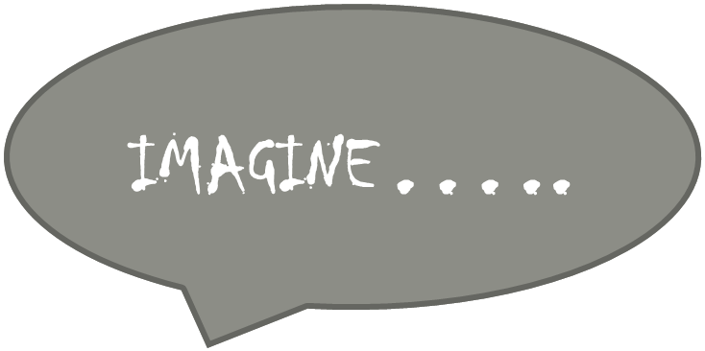



Slide 3
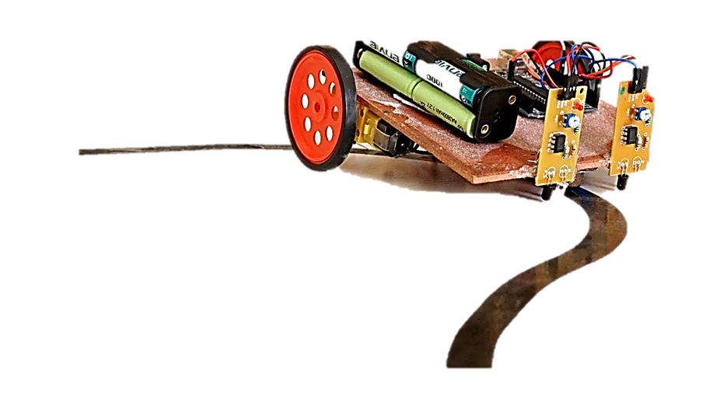
LINE FOLLOWING CAR

Slide 4
To be discussed…
1. What is a Line Following Car?
2. Working Principle.
3. Making your own car.
4. Circuit Map and Structure.
5. Benefits to our daily life.

Slide 5
What is a line following car?
It is a robot that will basically follow the path determined by the user. It will detect bright light using the sensors and will define its motion accordingly, maneuvering to stay on the course of the marked lines, curves and turns.
Sensors for line detection
Motor Driver
Motors for precise motion

Slide 6
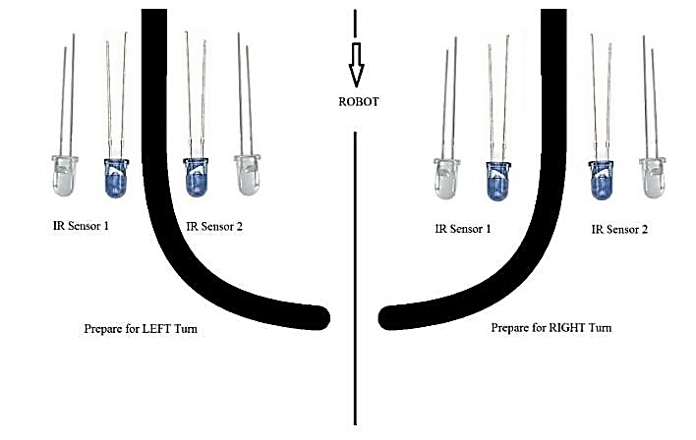
Working Principle: In our project, we developed a Line Follower Robot Car using simple gates which will detect the black line on the surface and move along that line. We setup the IR Sensors on the Line Follower Robot such that the two IR Sensors are on either side of the thickness of the black line on the floor. When the robot moves forward, both the sensors wait for the line to be detected. For example, if the IR Sensor 1 in the image detects the black line, it means that there is a right curve (or turn) ahead.

Slide 7
Making your own Robot CAR
Components used in our project.
Motor Driver L239D | 9V Battery
Regulator 7805 | Connecting Wires
Infrared sensors (26630201RP2) | wheels x 3 (2 motors)
NOT Gates (4069) x 2 | Motors x 2

Slide 8
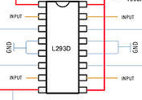
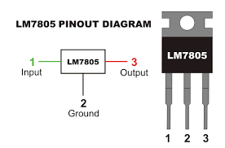
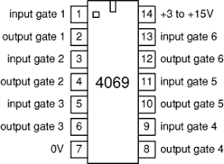
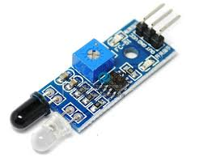
MOTOR DRIVER L239D
REGULATOR 7805
NOT GATE 4069
INFRARED SENSOR

Slide 9
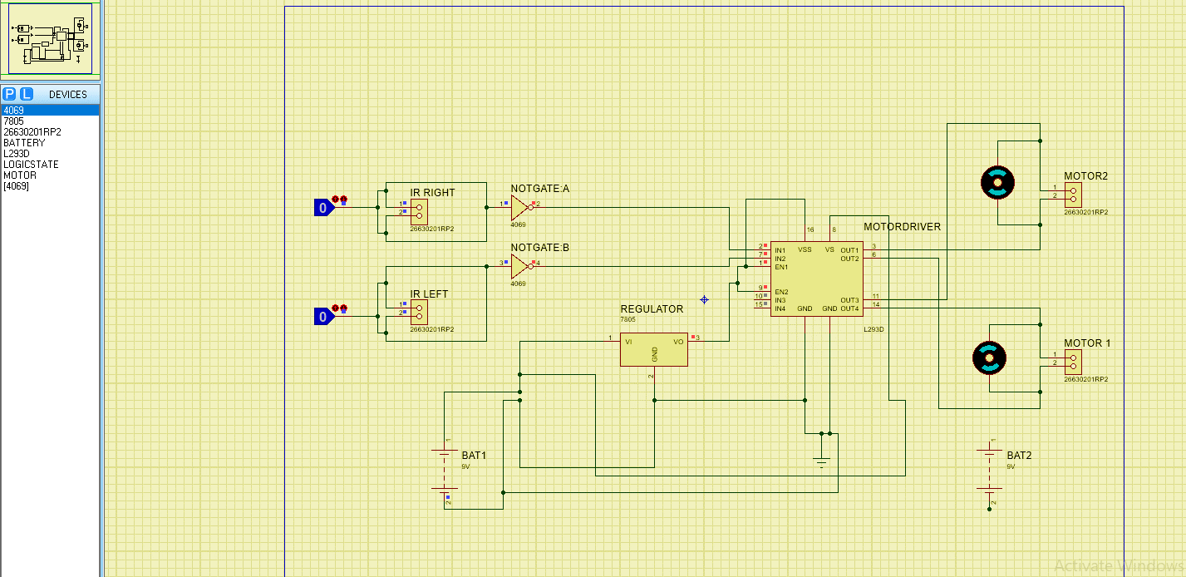


Slide 10
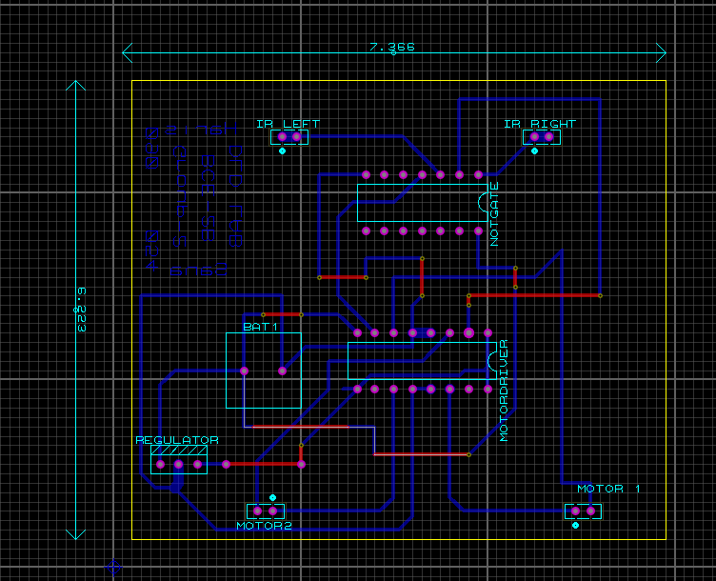
PCB (Printed Circuit Board)LAYOUT

Slide 11
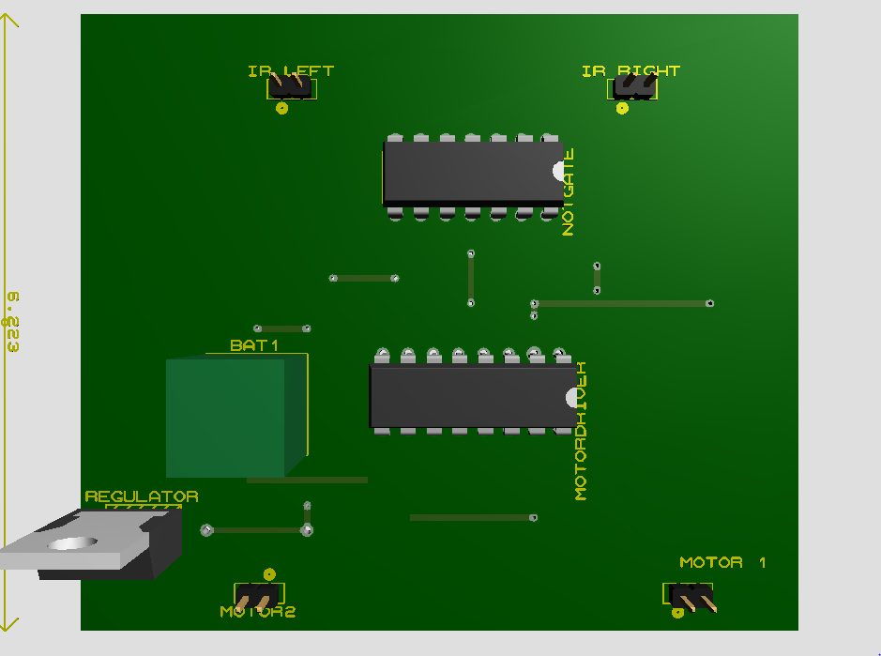
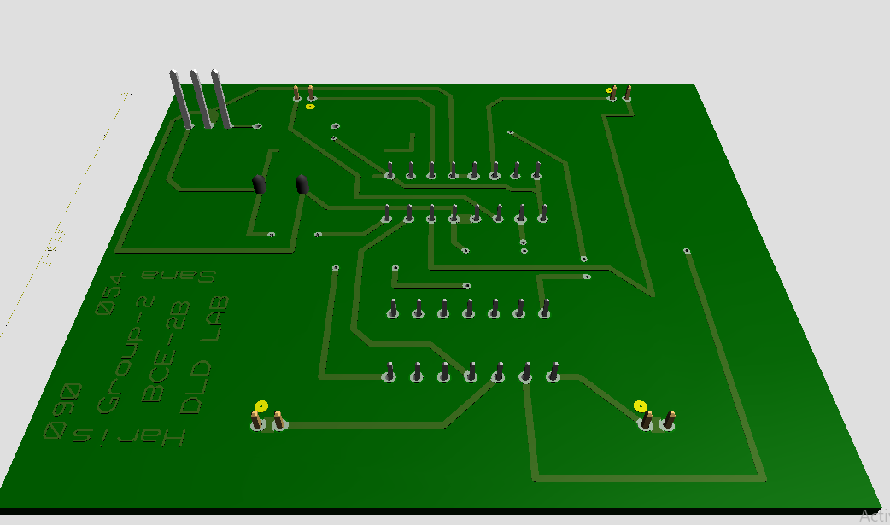
TOP VIEW
BACK VIEW

Slide 12
Line following Robot- An Advancement of Technology!
The line following Robot is basically an advanced automated mobile operator which is being successfully used in many industrial and public fields to aid the work burden as it requires no human operating and can perform repetitive tasks following its assigned trajectory path with supervision, thus making manual work easier for humans in this era of rapid, demanding and progressive lifestyle.
APPLICATIONS IN DAILY LIFE
Automated Cars.
Luggage carriers in Public Transport Centers.
Industrial automated equipment carriers.

Slide 13
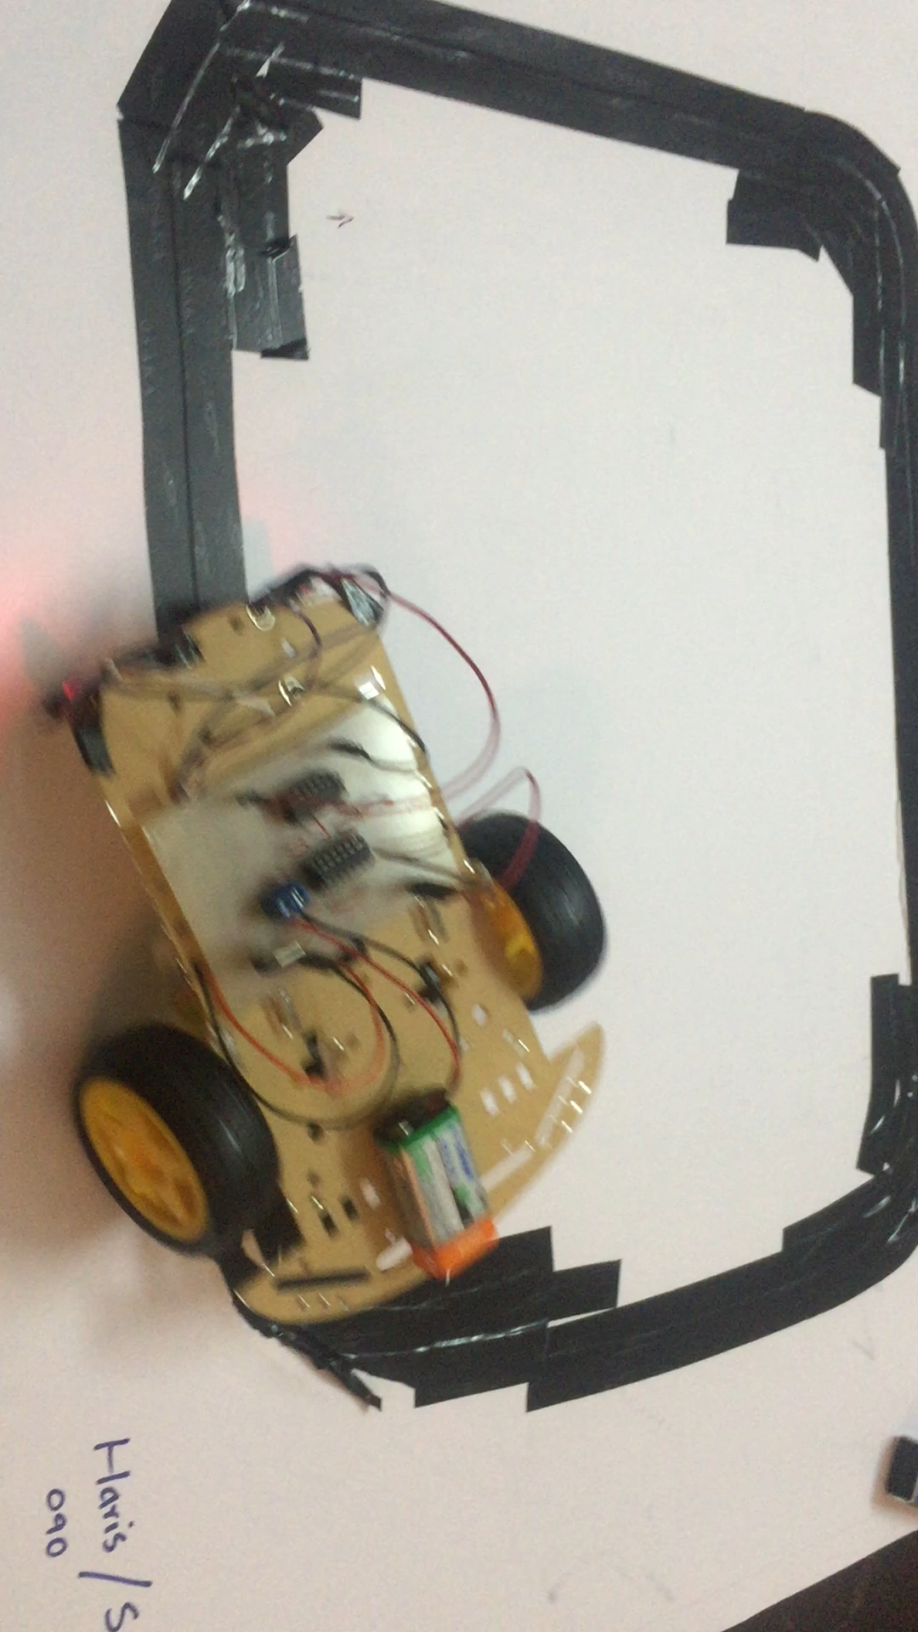

Slide 14
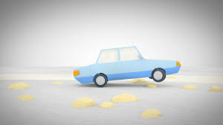
THANK YOU!!!

Slide 15


